Slide 1
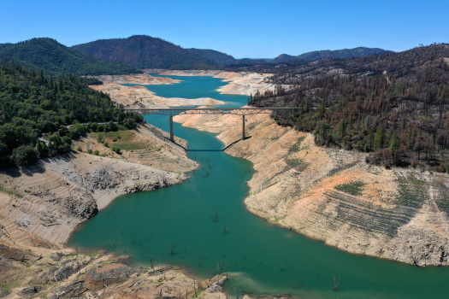
The Impact of Droughts on the Human Right to Water in California
Ben Rachunok, PhD
rachunok@stanford.edu

Slide 2
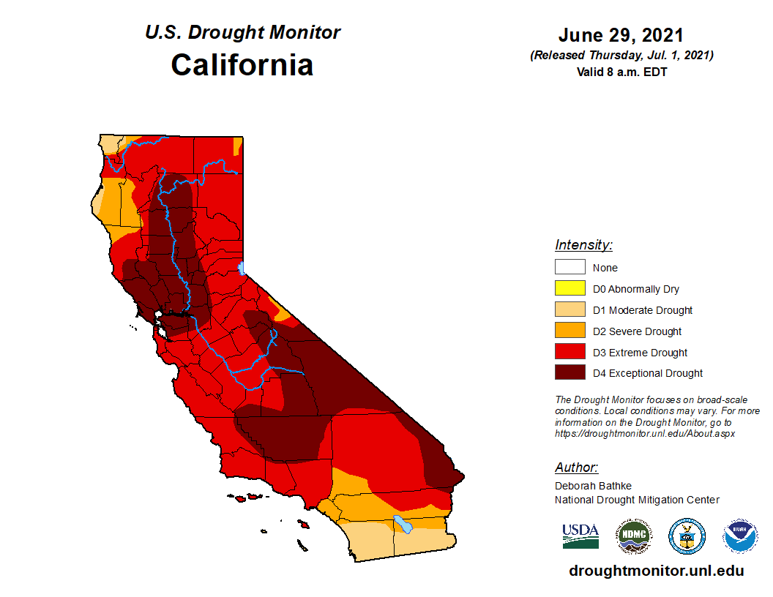
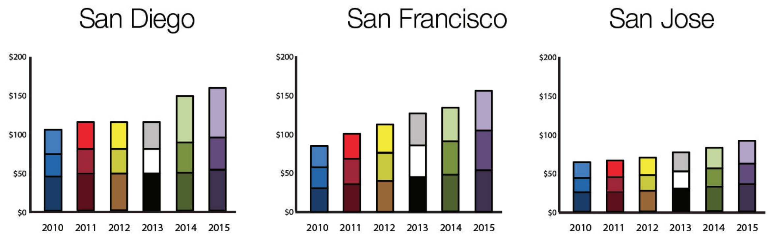
Two ongoing crises in California
Droughts
California continuing to face severe drought conditions
Water Affordability
Water rates rising faster than inflation across the US
In California, over 1,000,000 people lack access to clean, affordable, drinking water
California Drought Monitor
July 2021
Residential Water Rates, 2010-2015
Circle of Blue Water Rate Survey, 2019

Slide 3
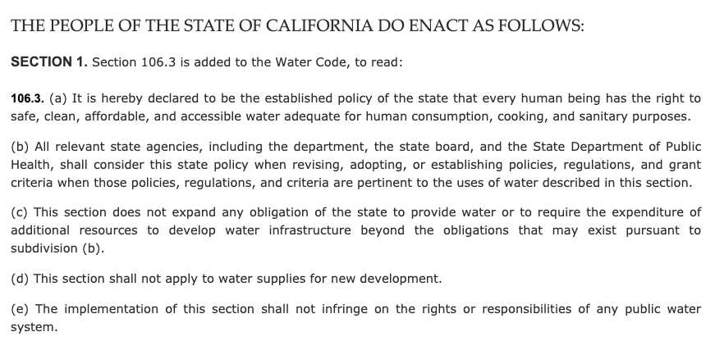
Human Right to Water (HR2W)

Slide 4
Water Affordability & Accessibility
Over 1,000,000 people in California lack access to clean, affordable drinking water
Likely worsened by droughts
Additional stress on water systems and utilities
Notionally
Sourcing additional water is more expensive --> costs passed on to rate-payers
Curtailing water use reduces utility revenue which gets re-couped through fees
Mitigation actions (particularly demand-side) reduce water access below acceptable minimums

Slide 5
Water Affordability & Accessibility
Over 1,000,000 people in California lack access to clean, affordable drinking water
Likely worsened by droughts
Additional stress on water systems and utilities
Notionally
Sourcing additional water is more expensive --> costs passed on to rate-payers
Curtailing water use reduces utility revenue which gets re-couped through fees
Mitigation actions (particularly demand-side) reduce water access below acceptable minimums

Slide 6
Water Affordability & Accessibility
Over 1,000,000 people in California lack access to clean, affordable drinking water
Likely worsened by droughts
Additional stress on water systems and utilities
Notionally
Sourcing additional water is more expensive --> costs passed on to rate-payers
Curtailing water use reduces utility revenue which gets re-couped through fees
Mitigation actions (particularly demand-side) reduce water access below acceptable minimums

Slide 7
Water Affordability & Accessibility
Over 1,000,000 people in California lack access to clean, affordable drinking water
Likely worsened by droughts
Additional stress on water systems and utilities
Notionally
Sourcing additional water is more expensive --> costs passed on to rate-payers
Curtailing water use reduces utility revenue which gets re-couped through fees
Mitigation actions (particularly demand-side) reduce water access below acceptable minimums

Slide 8
Water Affordability & Accessibility
Over 1,000,000 people in California lack access to clean, affordable drinking water
Likely worsened by droughts
Additional stress on water systems and utilities
Notionally
Sourcing additional water is more expensive --> costs passed on to rate-payers
Curtailing water use reduces utility revenue which gets re-couped through fees
Mitigation actions (particularly demand-side) reduce water access below acceptable minimums

Slide 9
Drought Mitigation Actions
Presently focusing on drought mitigation
E.g. Available water supply <= water demand

Slide 10
Drought Mitigation Actions
Presently focusing on drought mitigation
E.g. Available water supply <= water demand
Supply Side Examples
Building new infrastructure
Buying water on the spot-market
Transfer water from other utilities/wholesalers

Slide 11
Drought Mitigation Actions
Presently focusing on drought mitigation
E.g. Available water supply <= water demand
Supply Side Examples
Demand Side Examples
Building new infrastructure
Buying water on the spot-market
Transfer water from other utilities/wholesalers
Residential water conservation
Turf replacement
Progressive rate structures

Slide 12
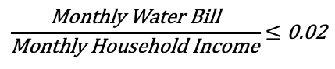
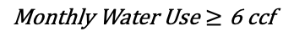
Our Model
Developing metrics that reflect community needs:
Affordability:
$$\frac{\text{Monthly} \text{Water} \text{Bill}}{\text{Monthly} \text{Household} \text{Income}}≤\text{0.02}$$
Access:
$$\text{Monthly} \text{Water} \text{Use}≥\text{6 }\text{ccf}$$

Slide 13
Water Rates
Residential Bill = 13.55 + 1(CCF) + 9.03(0-5CCF) + 10.86(6-7CCF) + 12.78(8-9CCF) + 15.74(CCF 10+ )
Yellow: Fixed Charge or Ready to Serve Charge
Red: Volumetric Charge
6 CCF (considered bare minimum for a family of 3) $78.54
10 CCF (Normal by some sources for a median family) $134.70

Slide 14
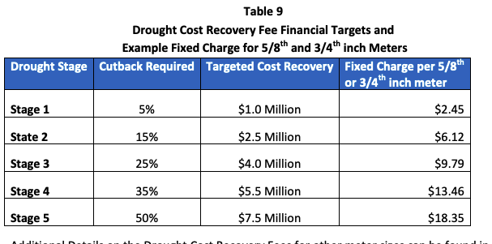
How do water rates change when conservation is enacted?
Conservation requirements mean less water used, less revenue for utilities
Revenue recovery accomplished through drought surcharges (right)
Flat rate increase to fixed charge
Over half of drought surcharges work this way (Feinstein 2018)
Surcharges for example utility in California

Slide 15
How do water rates change when conservation is enacted?
Conservation requirements mean less water used, less revenue for utilities
Revenue recovery accomplished through drought surcharges (right)
Flat rate increase to fixed charge
Over half of drought surcharges work this way (Feinstein 2018)
Cutbacks
Monthly bill
increases

Slide 16
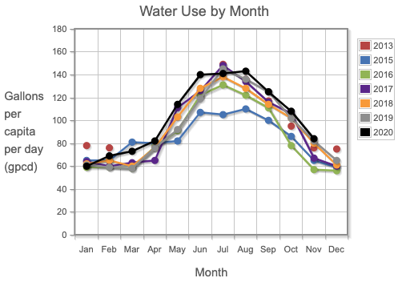
Household water demand
Unit of measure for residential demand is household
Start with median per-person-per-month water consumption in non-drought years
Reported by SWRCB

Slide 17
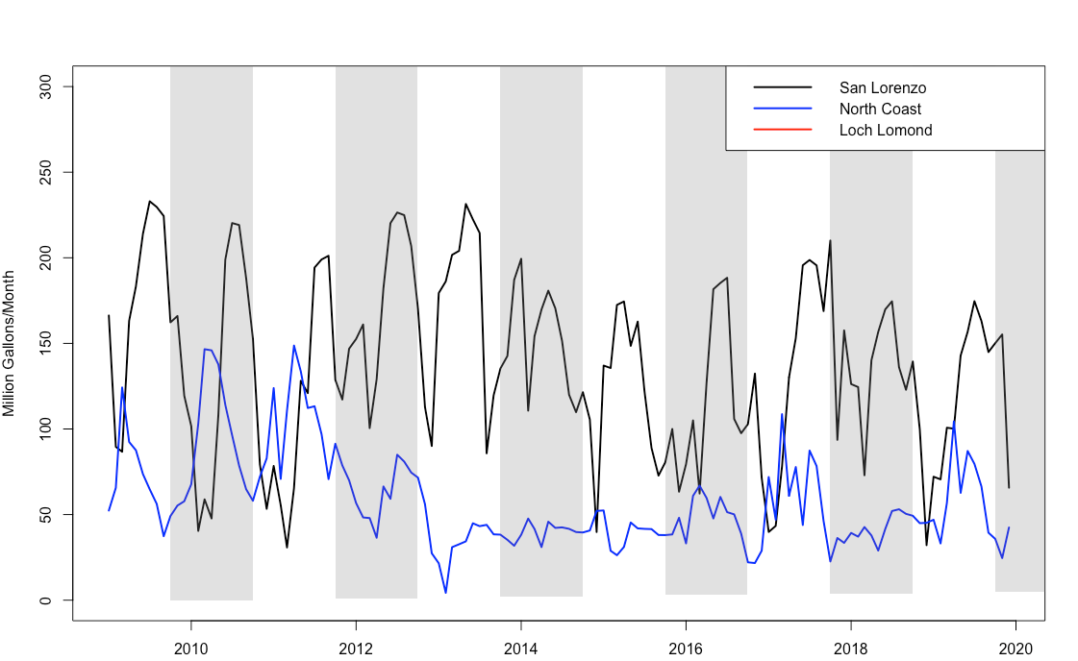
Historical Curtailment Decisions
5% reduction
25% reduction

Slide 18
Alternative Curtailment Decisions
15% reduction

Slide 19
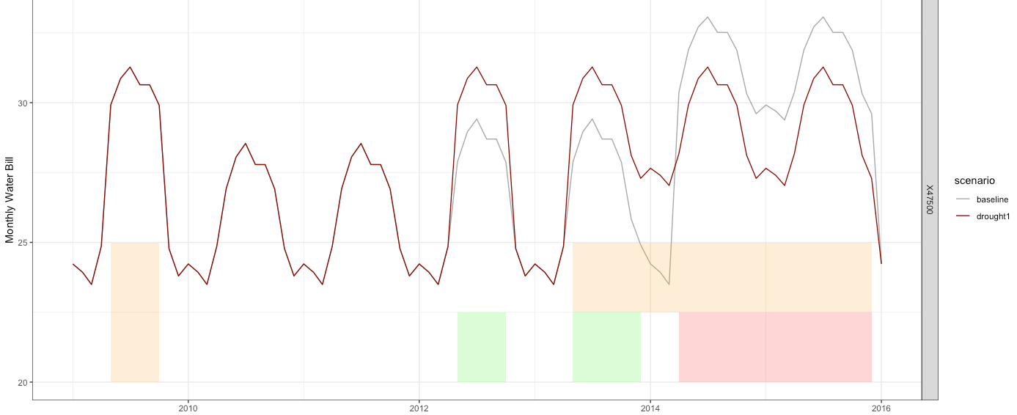
Water bill for household income $47,500
Example water bill per month for household making $47,500/year
Light line: monthly bill for historical decisions
Dark line: monthly bill for alternative decisions
Takeaway: droughts increase water rates & increase is dependent on utility decision making
Alternative
15%
15%
5%
5%
25%
Baseline

Slide 20
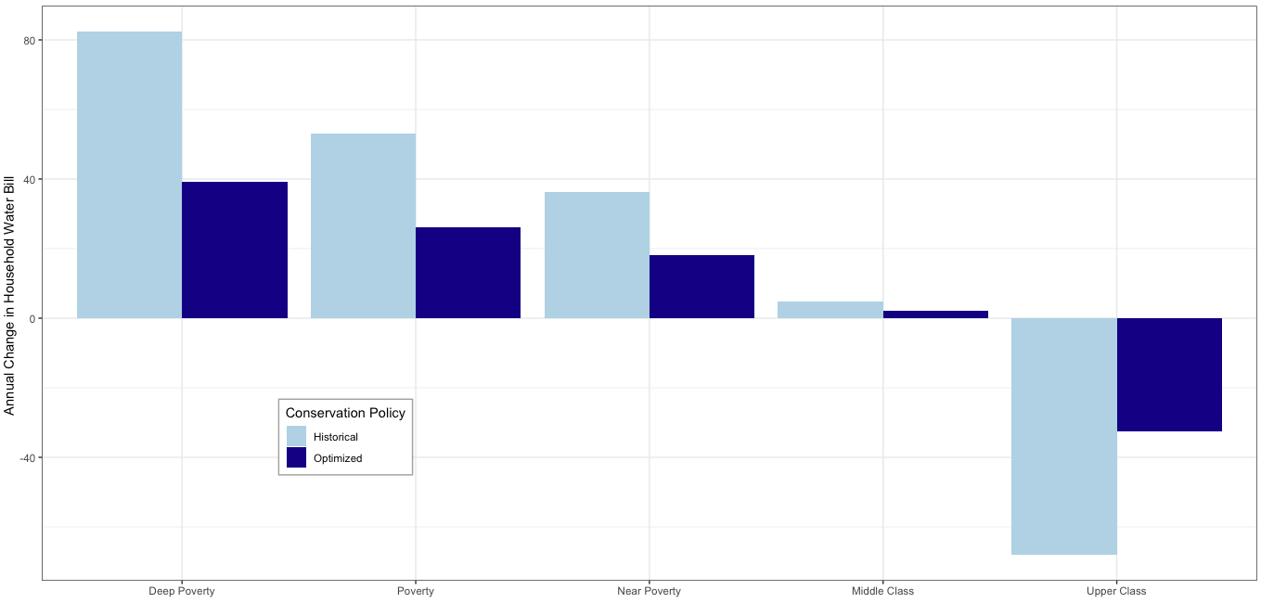
Who experiences these changes?
Annual change in water bill pre-drought vs. during-drought broken down by income class

Slide 21
Who experiences these changes?
Bills go up for lower-income households
Fixed charges make up a large proportion of their bills

Slide 22
Who experiences these changes?
Bills go up for lower-income households
Fixed charges make up a large proportion of their bills
Bills go down for high-income households
Amount saved by reducing water use > added fees

Slide 23
Who experiences these changes?
Improving conservation policies can reduce burden on households

Slide 24
Ongoing work…
Designing progressive revenue recouperations
Building infrastructure (desalination plant, recycled water, groundwater storage/recovery)
Dependence on household size, income, distributions
Designing low-income water rate assistance
Water access

Slide 25
The Impact of Droughts on the Human Right to Water in California
Questions
Ben Rachunok, PhD
rachunok@stanford.edu

Slide 26
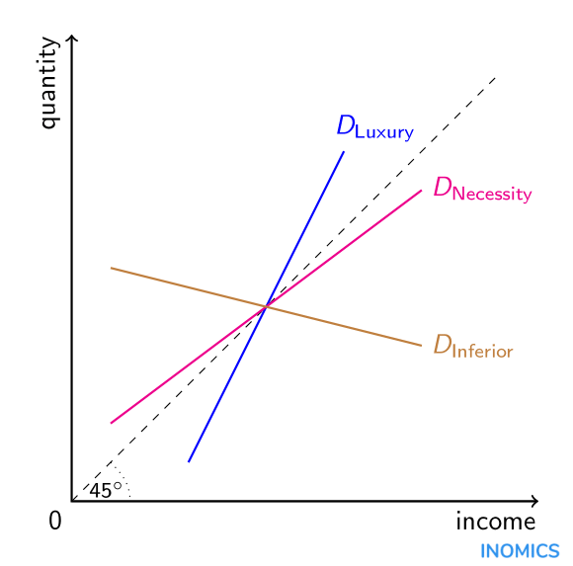
Household water demand
Adjust baseline water use based on household income
Using price elasticity of water demand
“Given a 1% increase in my income, how much more water do I consume?”
Lots of work by our friends in the economics world trying to estimate this value. We use 0.1
Elasticity value is slope of the line

Slide 27
Household water demand
EXAMPLE
Water use for median income: 100G/month
What’s the water use for someone making 150% of median income?
50% increase in income
Change in Income x Income Elasticity = Change in Quantity
50% increase x 0.41 = 20.5% increase in water use
= 120.5 G /month
Elasticity value is slope of the line

Slide 28
Household water demand
Use this to adjust water uses for 16 different income classes:
Household incomes of $7,500/yr all the way to up to $250,000+/yr
Calculate average size of households in each income class
Multiply income-adjusted per-person water use by household size to get a household water use
Elasticity value is slope of the line

Slide 29
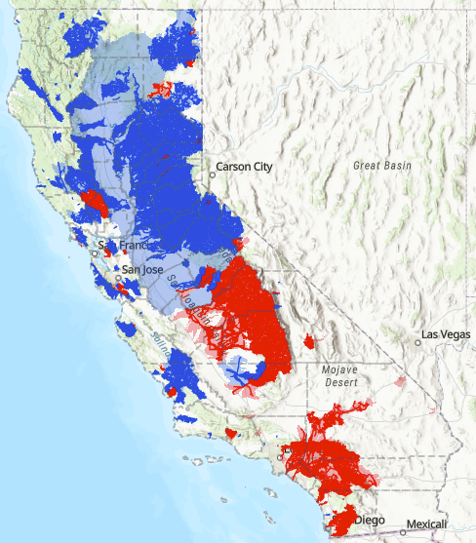
To start: retrospective of 2012-2016 drought
Last updated in 1998 when California had 20% less people
Many more shortfalls unadjudicated
There wasn’t enough water but the water rights holders didn’t ask the state to step in
Fully Appropriated Stream Systems (FASS) mean the ‘average’ streamflow ≈ total water rights
Red: No new water rights can be issued
Blue: No new summer water rights can be issued

Slide 30
Water Balance
Net Reservoir Evaporation
Spillage (if necessary)
Surface Water Sources
Groundwater
Volume of water stored at t
Demand (adjusted)
Environmental outflow
Natural inflow to reservoir
Volume of water stored at t+1

